Slide 1
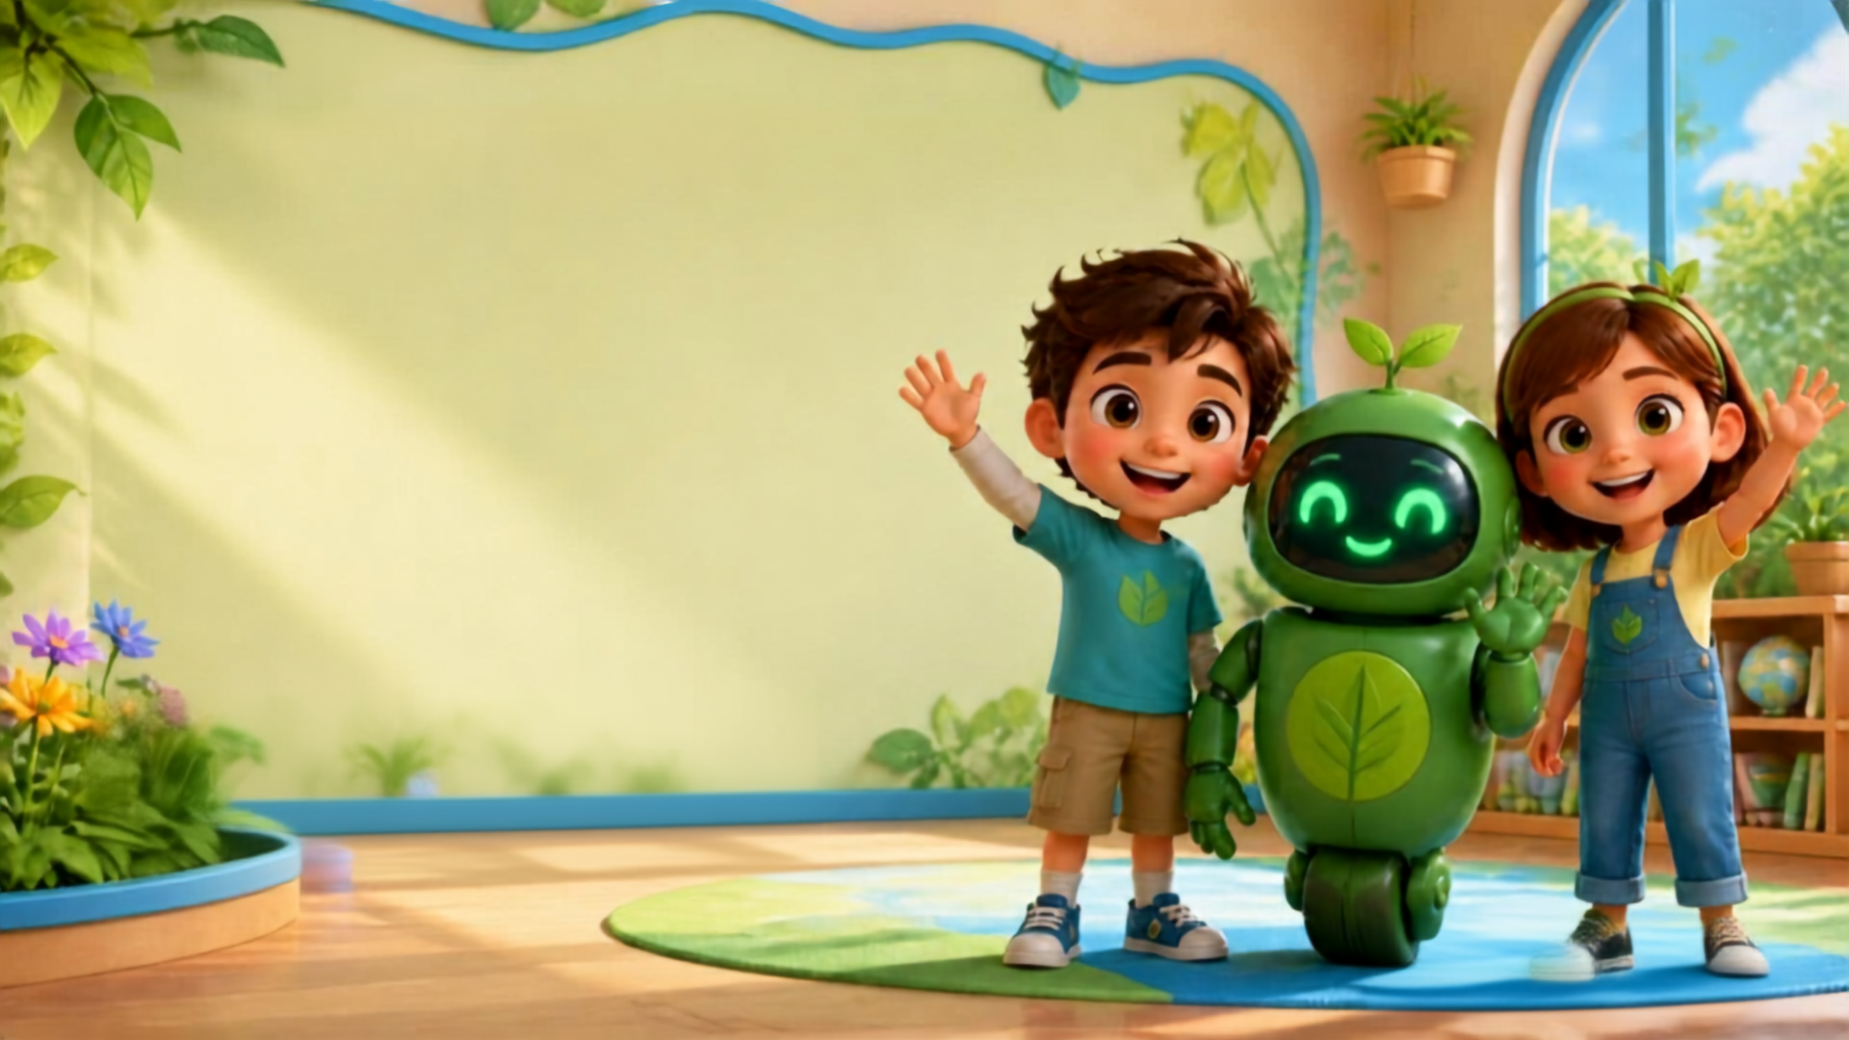

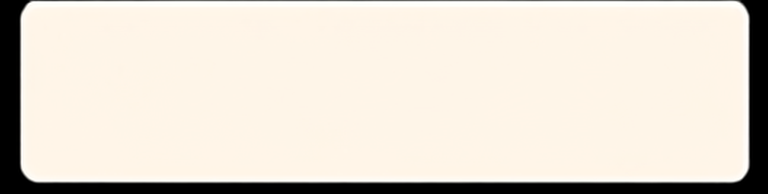


1 / 13
LESSON 6 - HELLO! BLUE!
Hello!
LITTLE SEEDS! MONTH 1
RemoeUPH
Notes:
TEACHER SCRIPT
Hello everyone! Welcome to RemoEd! My name is Teacher [Name]. Say hello to our friends! [Wave]

Slide 2
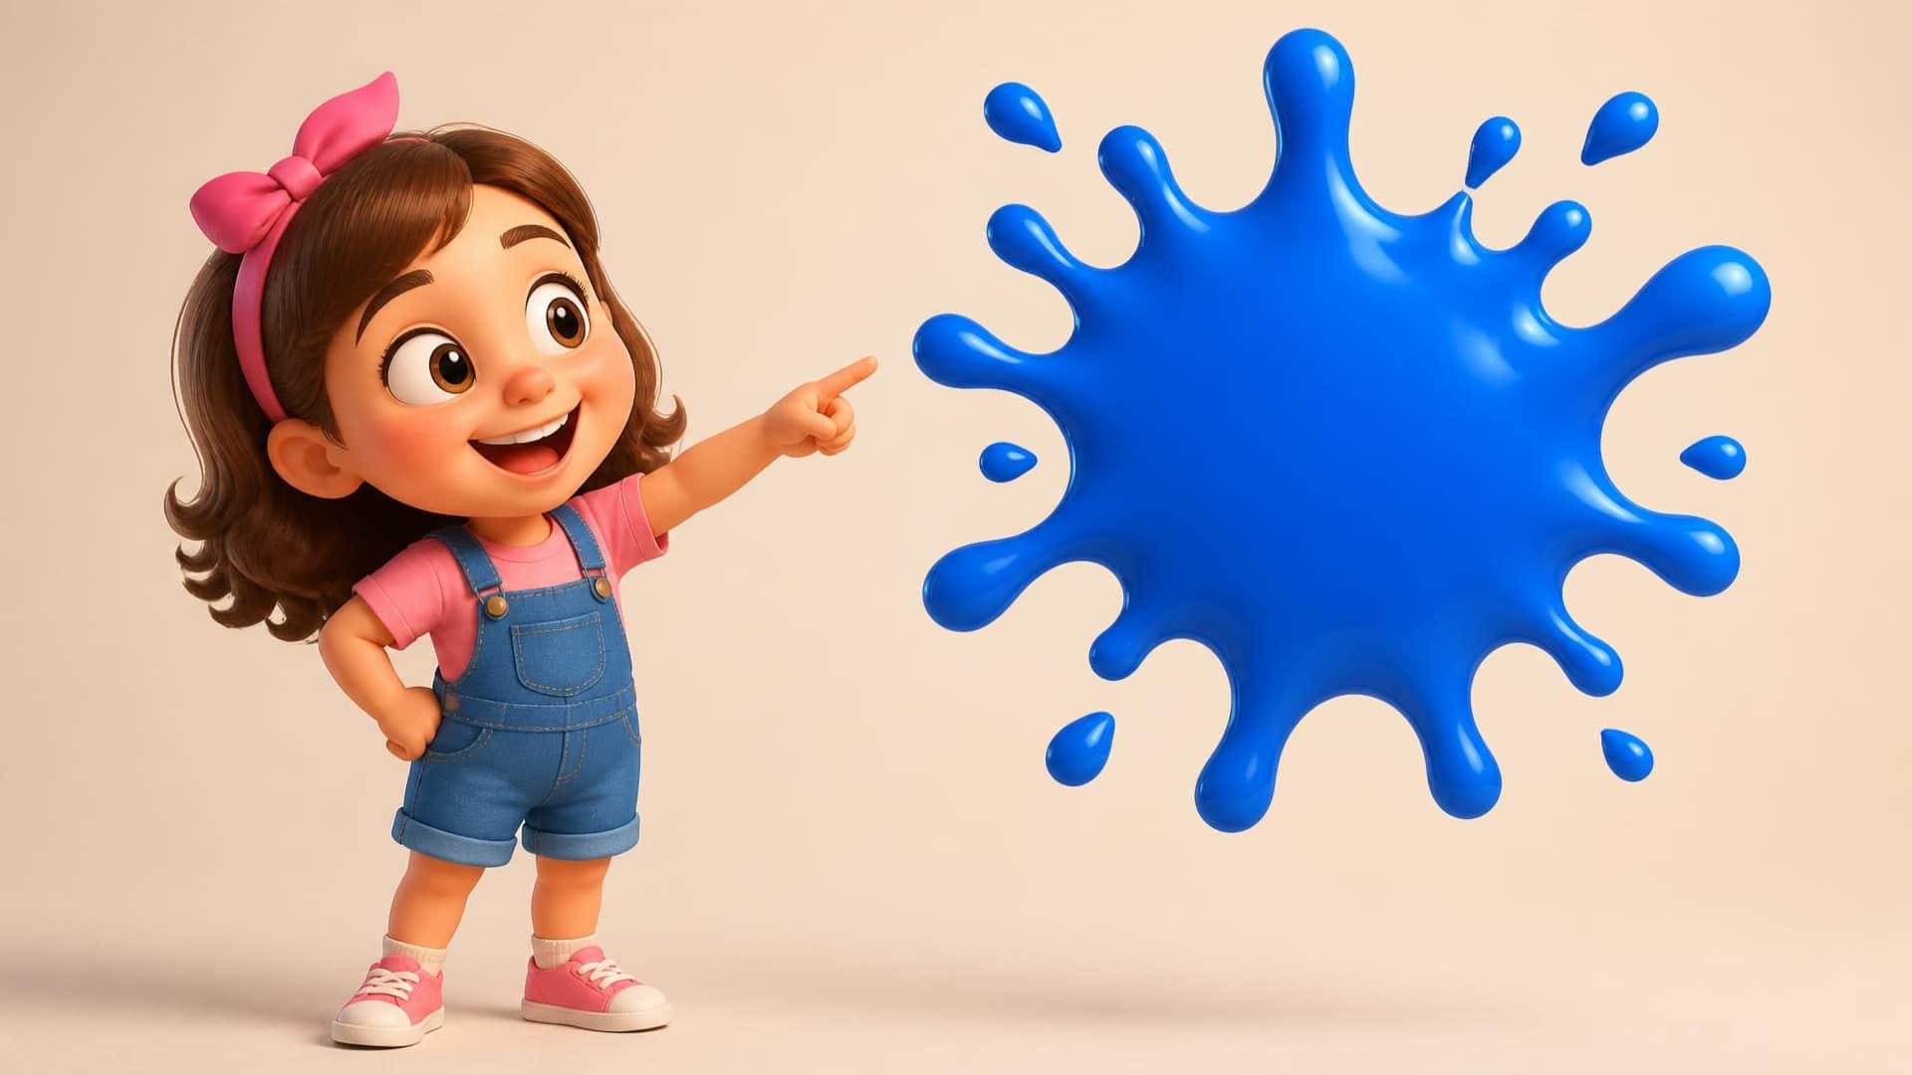

LESSON 6 - Hello! Blue!
2 / 13
Blue.
LITTLE SEEDS! MONTH 1
Notes:
TEACHER SCRIPT
Today, we have a new color! Listen: Blue. [Point to mouth] B-l-ue. Can you say Blue? [Cup ear] It is blue.

Slide 3

LESSON 6 - Hello! Blue!
3 / 13
Sky.
LITTLE SEEDS! MONTH 1
Notes:
TEACHER SCRIPT
Look up high! [Point up] What is this? Listen: Sky. Say: Sky! [Wait] What color is the sky? Yes, it is blue!

Slide 4
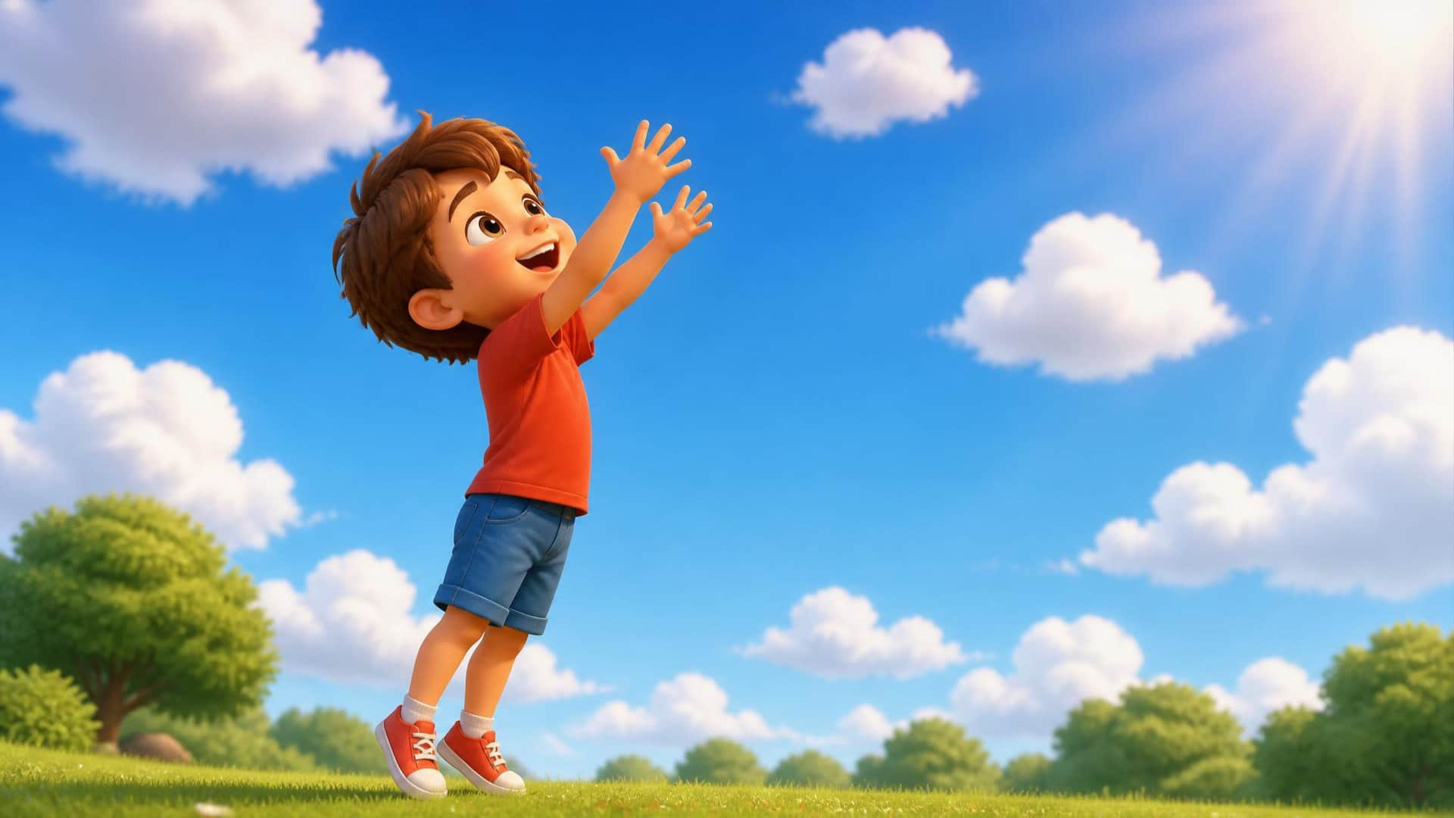
LESSON 6 - Hello! Blue!
4 / 13
Reach up!
LITTLE SEEDS! MONTH 1
Notes:
TEACHER SCRIPT
Let's touch the blue sky! Reach up, up, up! [Stretch arms high] Very tall! Good job!

Slide 5
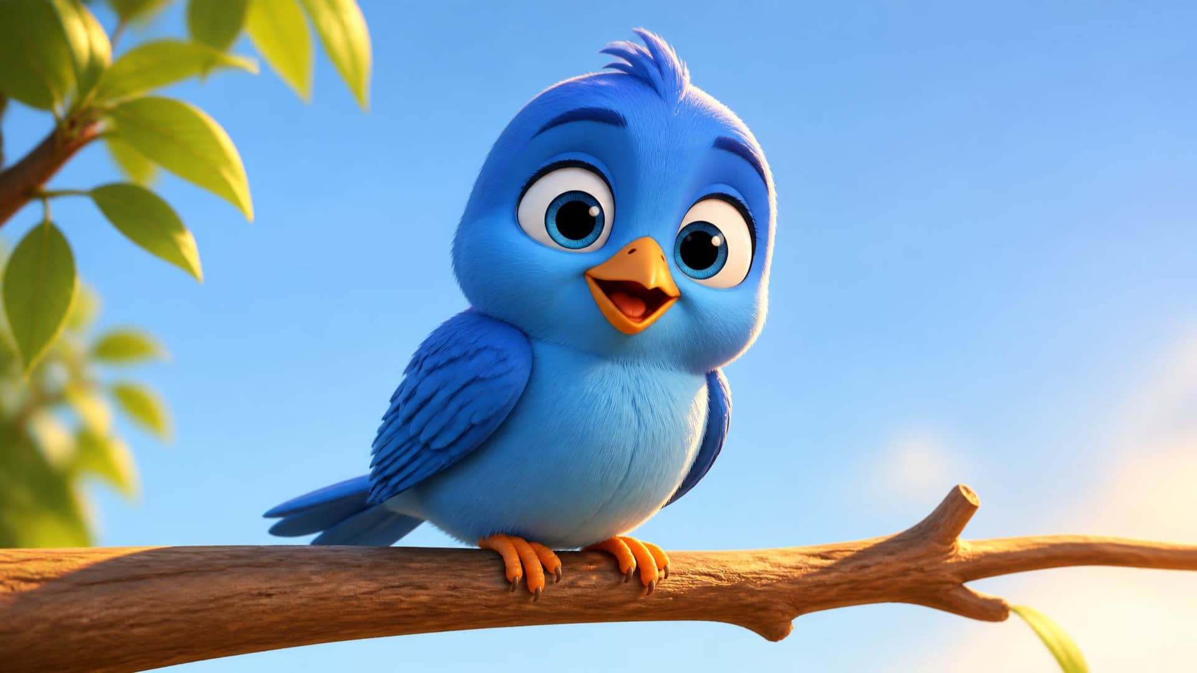
LESSON 6 - Hello! Blue!
5 / 13
Bird.
LITTLE SEEDS! MONTH 1
Notes:
TEACHER SCRIPT
Look in the tree! What is this? Listen: Bird. Say: Bird! [Cup ear] What color is the bird? It is blue!

Slide 6
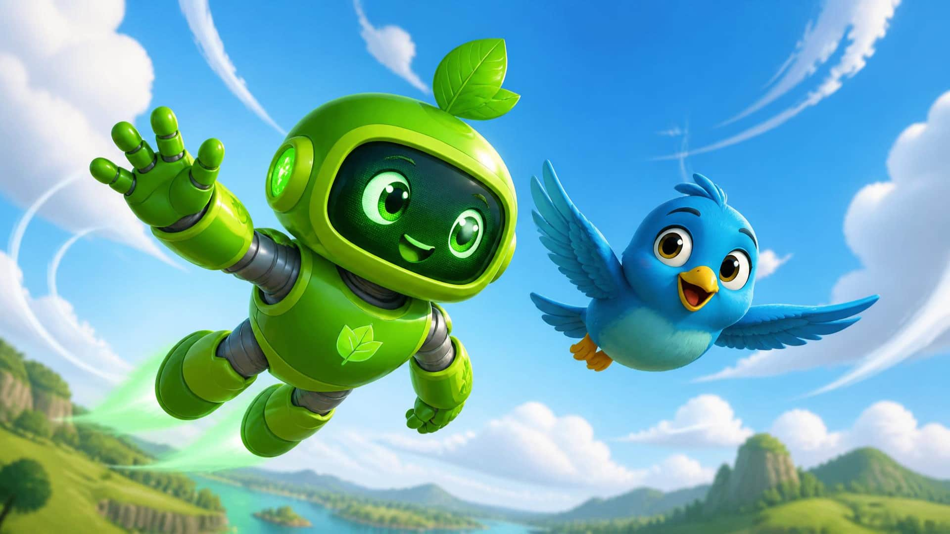
LESSON 6 - Hello! Blue!
6 / 13
Flap, flap!
LITTLE SEEDS! MONTH 1
Notes:
TEACHER SCRIPT
Let's be a blue bird! Flap your wings! [Flap arms up and down] Flap, flap, flap! Fly high in the sky!

Slide 7
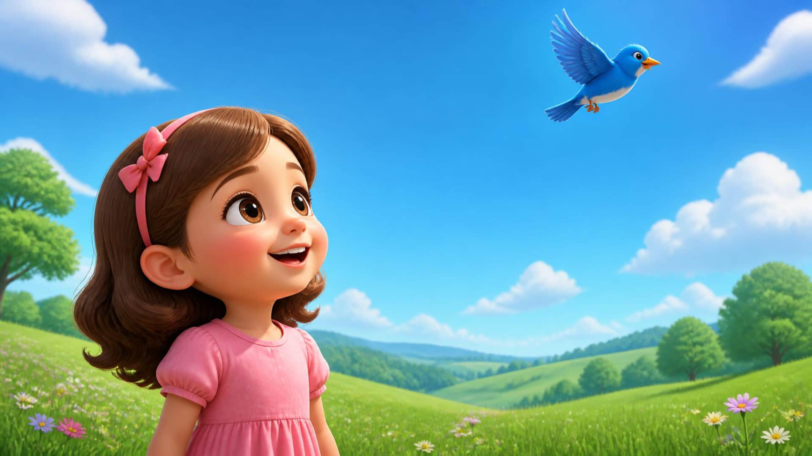
LESSON 6 - Hello! Blue!
7 / 13
Keep it clean.
LITTLE SEEDS! MONTH 1
Notes:
TEACHER SCRIPT
The blue bird loves the clean sky. We love clean air to breathe! [Take a deep breath in and out] Ahhh.

Slide 8

LESSON 6 - Hello! Blue!
8 / 13
God made the blue sky.
LITTLE SEEDS! MONTH 1
Notes:
TEACHER SCRIPT
Who made the beautiful blue sky? [Point up] God made the sky! Thank you, God, for the color blue! [Clap hands gently]

Slide 9
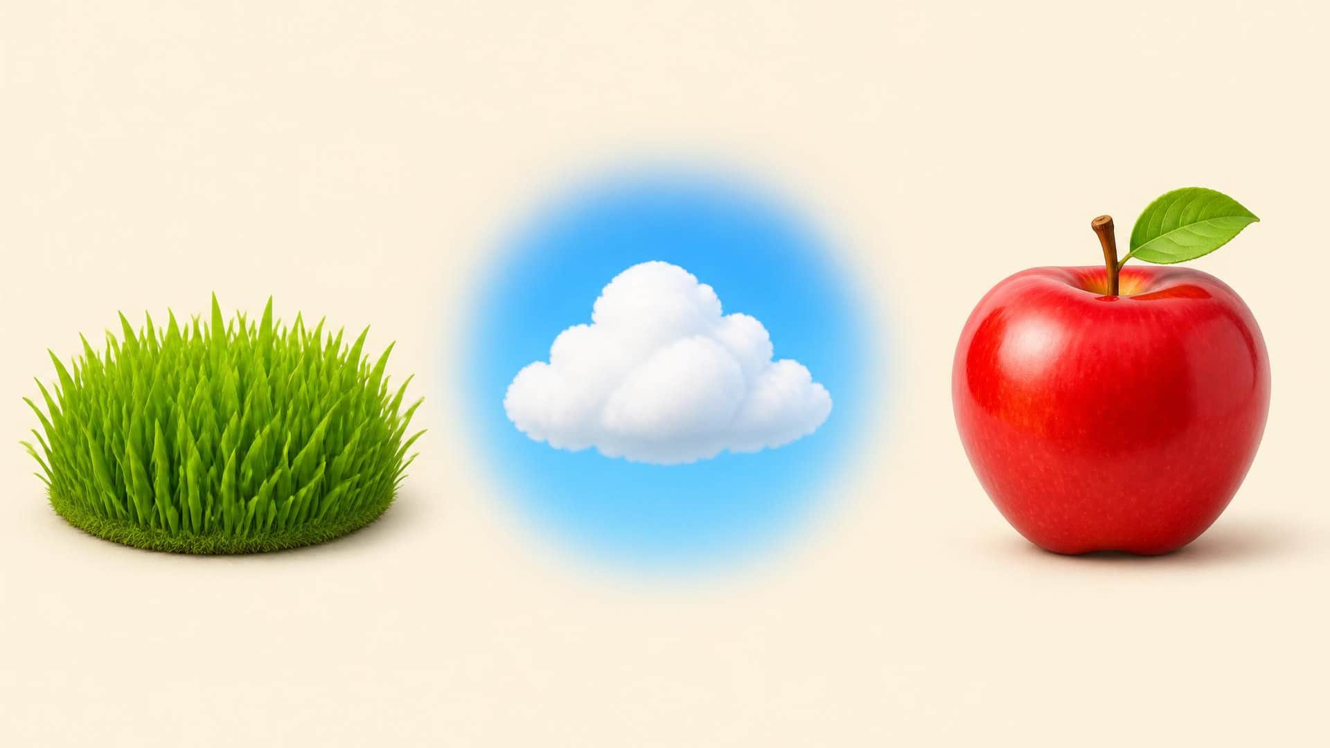
LESSON 6 - Hello! Blue!
9 / 13
Where is the sky?
LITTLE SEEDS! MONTH 1
Notes:
TEACHER SCRIPT
Game time! Where is the blue sky? Touch the sky! [Wait for student to tap] Yes! It is blue.

Slide 10
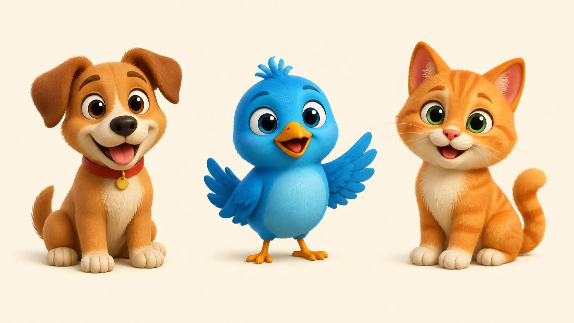
LESSON 6 - Hello! Blue!
10 / 13
Where is the bird?
LITTLE SEEDS! MONTH 1
Notes:
TEACHER SCRIPT
Where is the blue bird? Touch the bird! [Wait for tap] Good job! Tweet, tweet!

Slide 11
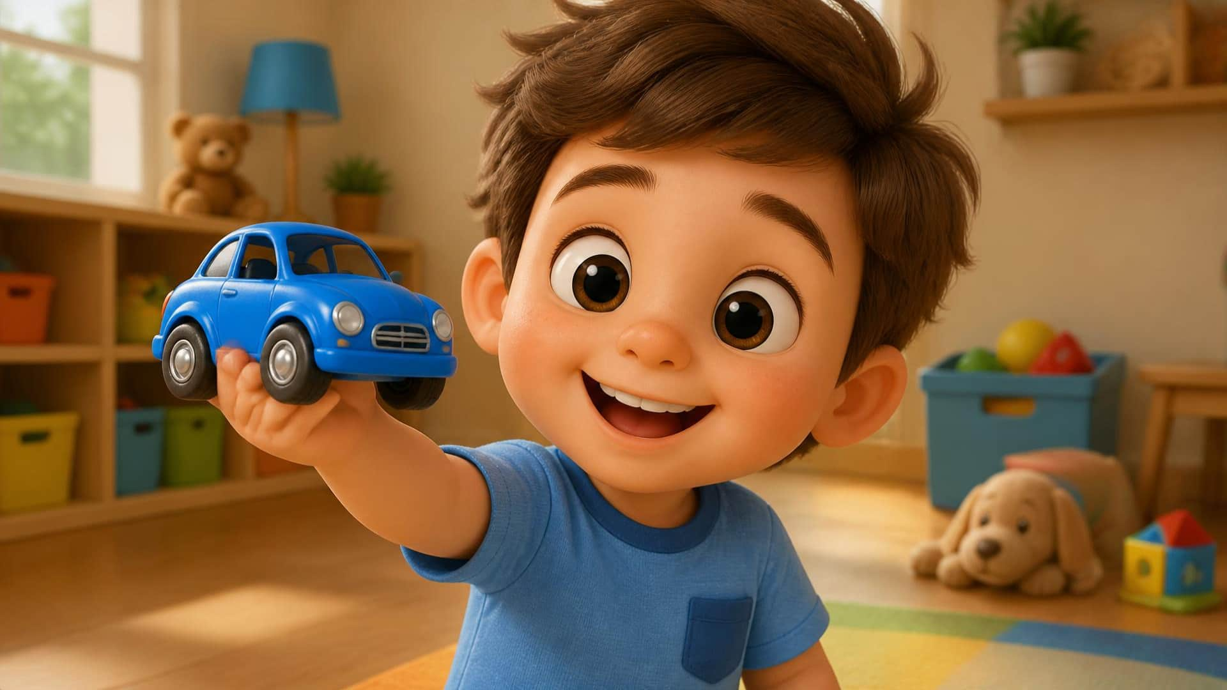
LESSON 6 - Hello! Blue!
11 / 13
Your turn!
LITTLE SEEDS! MONTH 1
Notes:
TEACHER SCRIPT
Your turn! Show me something blue! [Wait for them to find an object] Wow! That is blue!

Slide 12
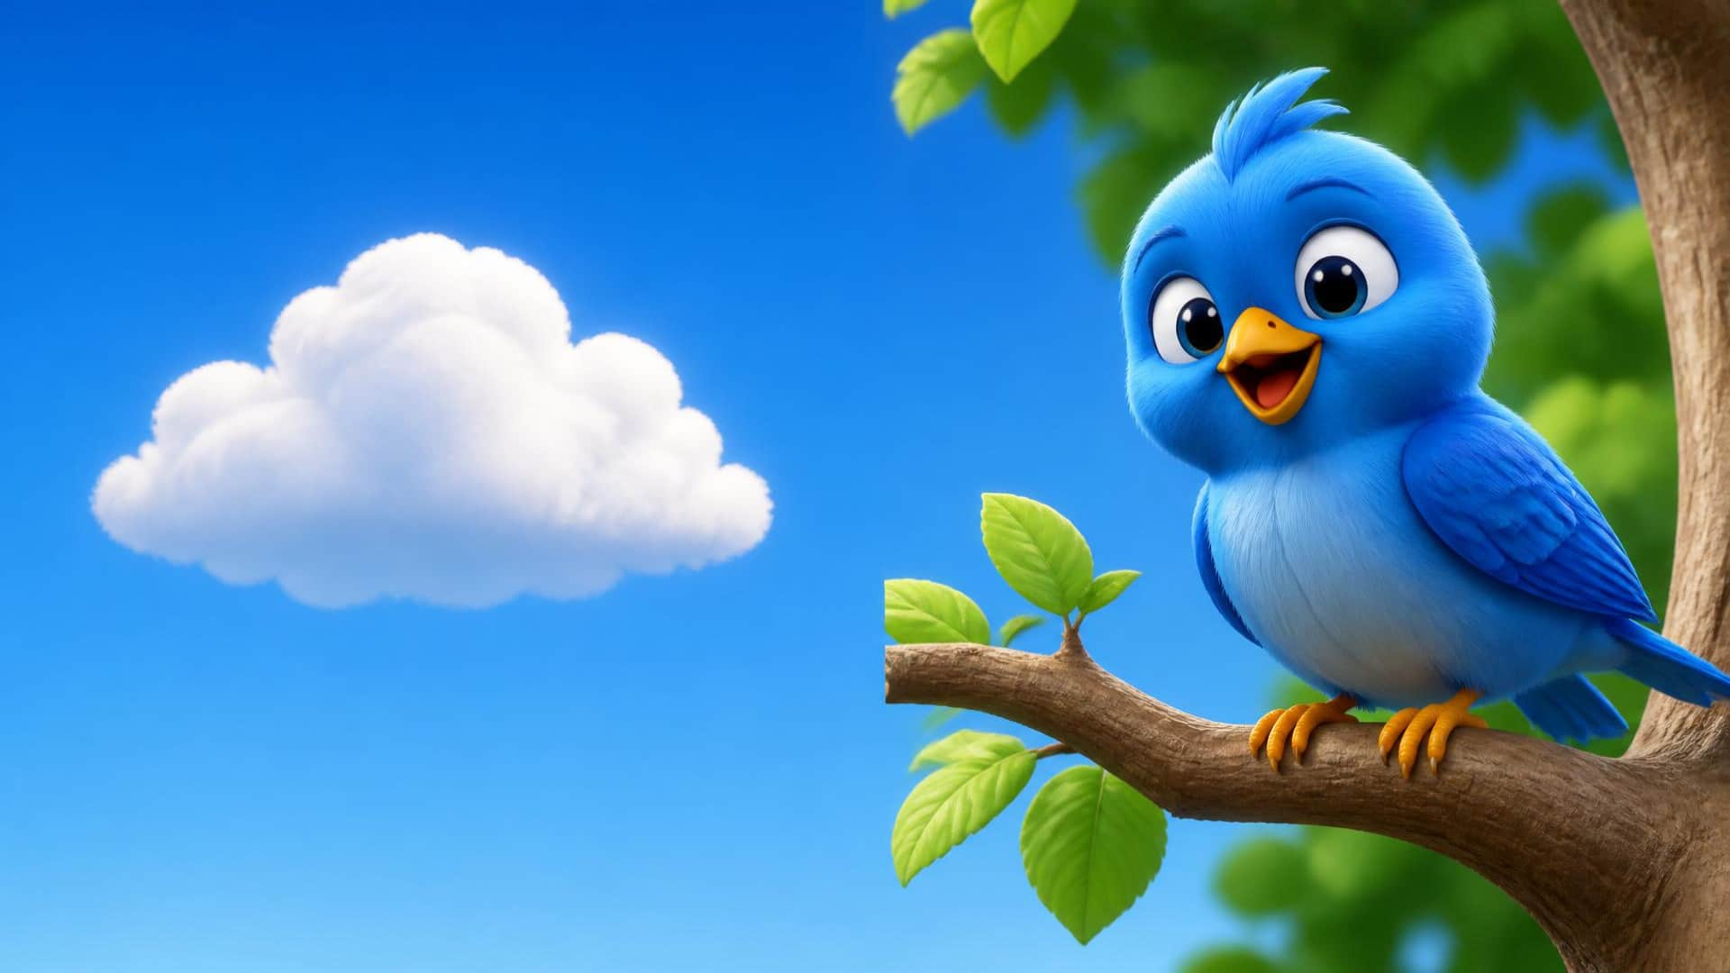
LESSON 6 - Hello! Blue!
12 / 13
Blue Sky. Blue Bird.
LITTLE SEEDS! MONTH 1
Notes:
TEACHER SCRIPT
You are amazing! Say: Blue Sky! [Wait] Say: Blue Bird! [Wait] Excellent!

Slide 13
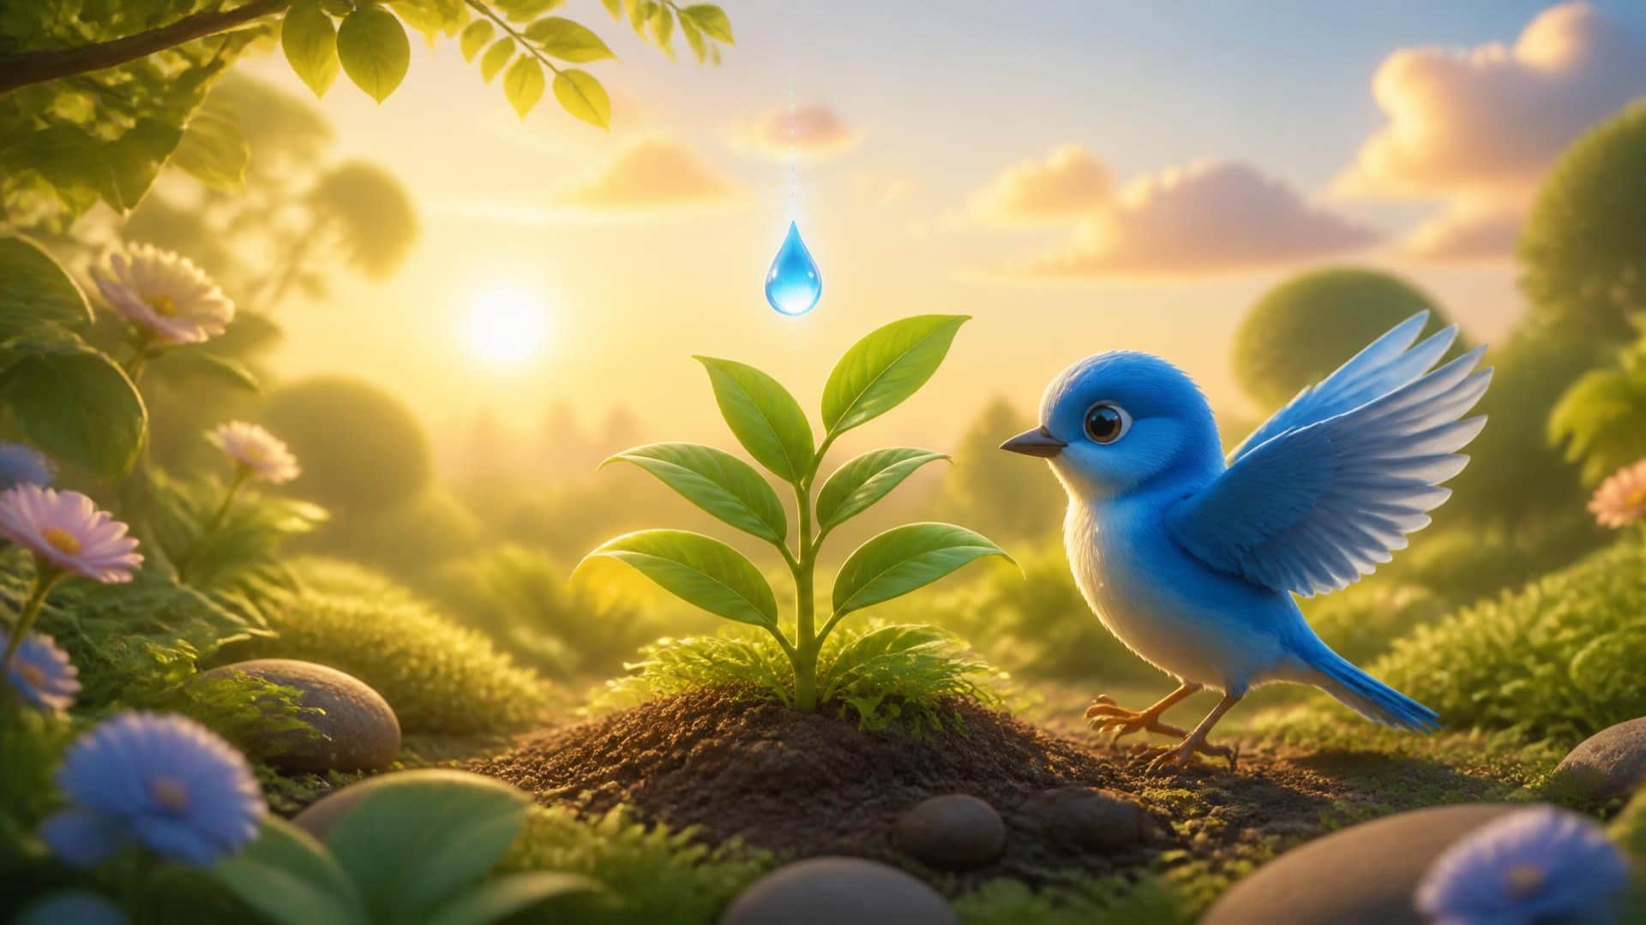
LESSON 6 - Hello! Blue!
13 / 13
Goodbye!
LITTLE SEEDS! MONTH 1
Notes:
TEACHER SCRIPT
An Eco-Drop for you! Look, a blue bird is visiting your garden! Time to say goodbye. Goodbye! [Wave]

